Slide 1
Exploratory Data Analysis and Machine Learning for Predicting Lifestyle Choices
Team members
Doaa Mohamed
Jehad Essam
Mariam Badr
Mohamed Mostafa
Mohamed Essam
Notes:
Good evening, everyone! My name is Mariam Badr And I’m here today to present our project idea under title Exploratory data analysis and machine learning for predicting lifestyle choices.

Slide 2
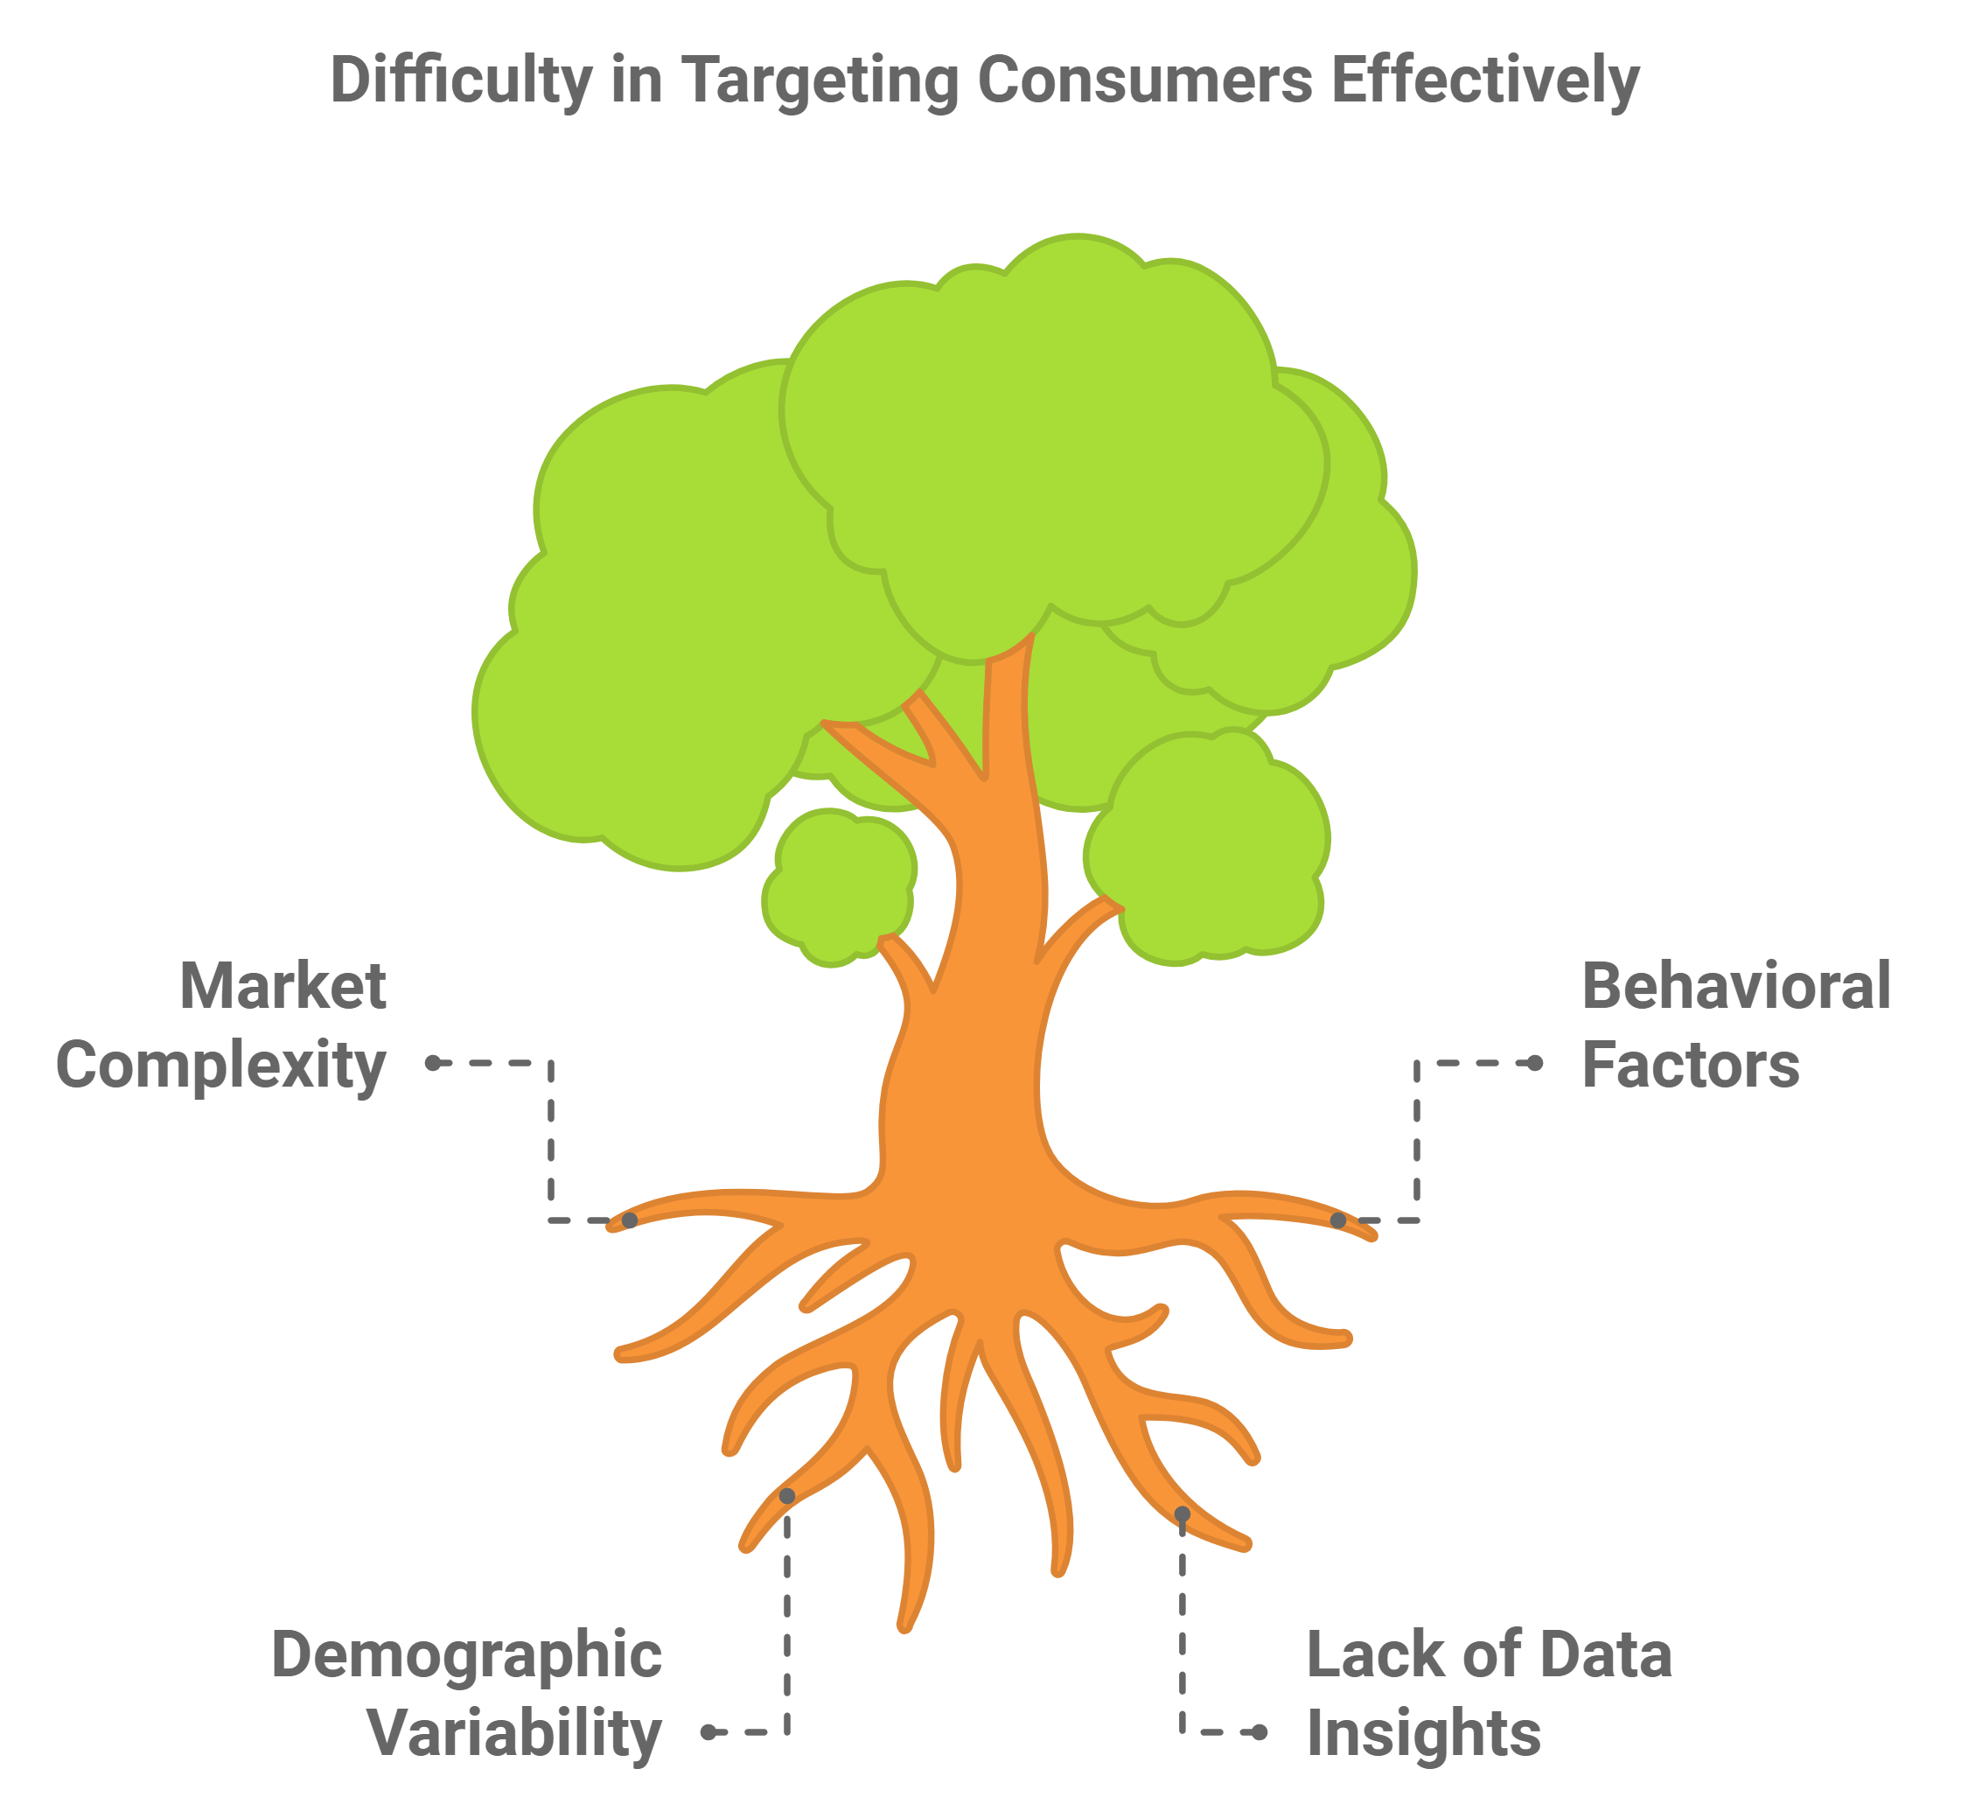
Companies face challenges in targeting the right customers in today's complex consumer markets. Our project addresses this by predicting lifestyle choices using behavioral and demographic factors, helping businesses tailor products and services to specific customer needs.
Problem Description
Notes:
So, lets’ start with the problem we are addressing here. We noticed that some companies face a lot of challenges when comes to targeting their customers. And there are many factors that could affect this difficulty such as: the constant growth of markets and customers needs and expectation which lead to market complexity. Besids the variability in the customers behavous and demographics features. And also the lack of the data insights, although there is a huge amount of data, amny companied lack the knowledge of how to exract valuable insights from it.
Our project addresses this problem by using data to predict lifestyle choices. Through this project we aim to help businesses tailor their products and services to meet the specific needs of different customer segments, By analyzing a variety of demographic and behavioral factors.

Slide 3
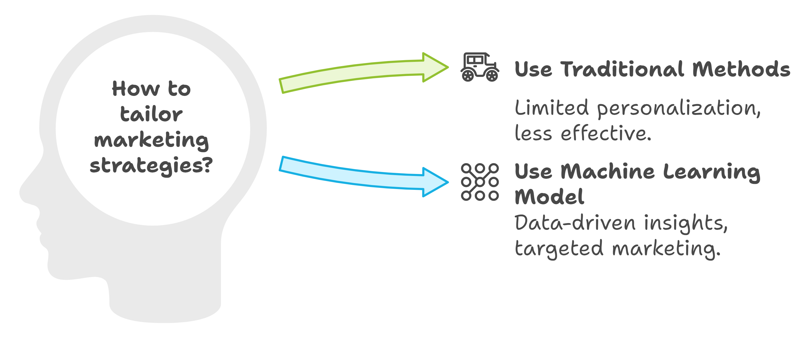
We developed a machine learning model that analyzes user data and predicts their lifestyle choices, enabling stakeholders to tailor marketing strategies effectively.
Proposed Solution
3

Slide 4
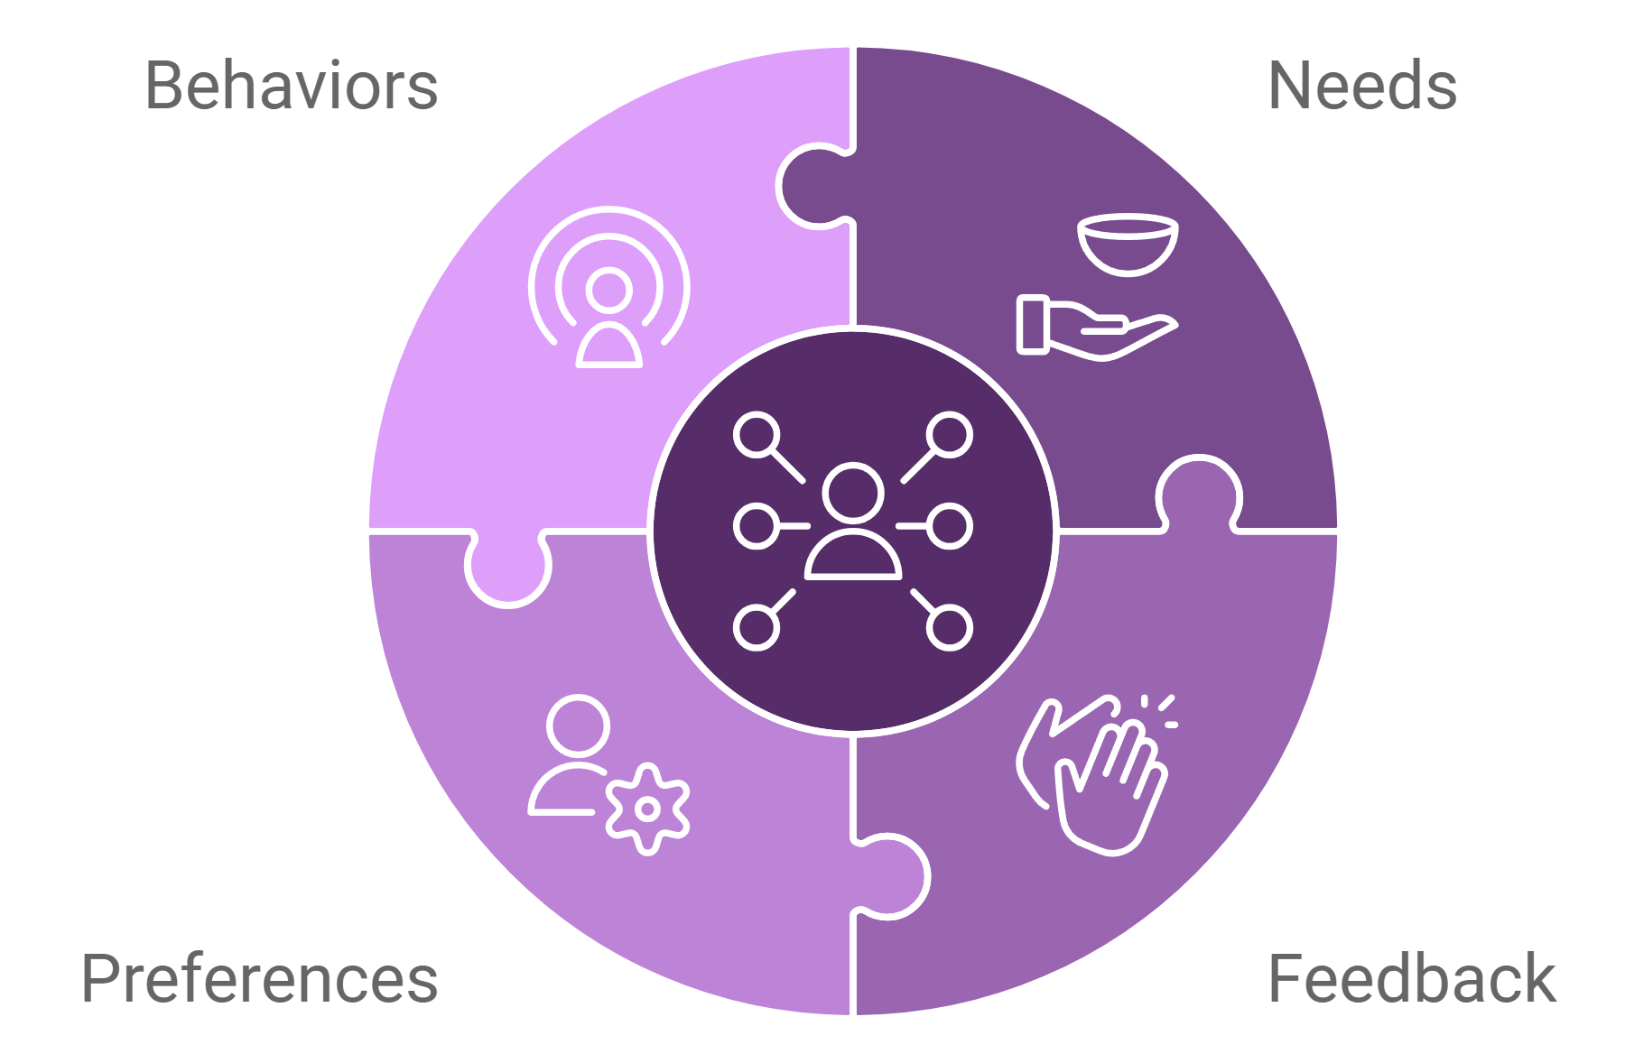
End Users and Features

Slide 5
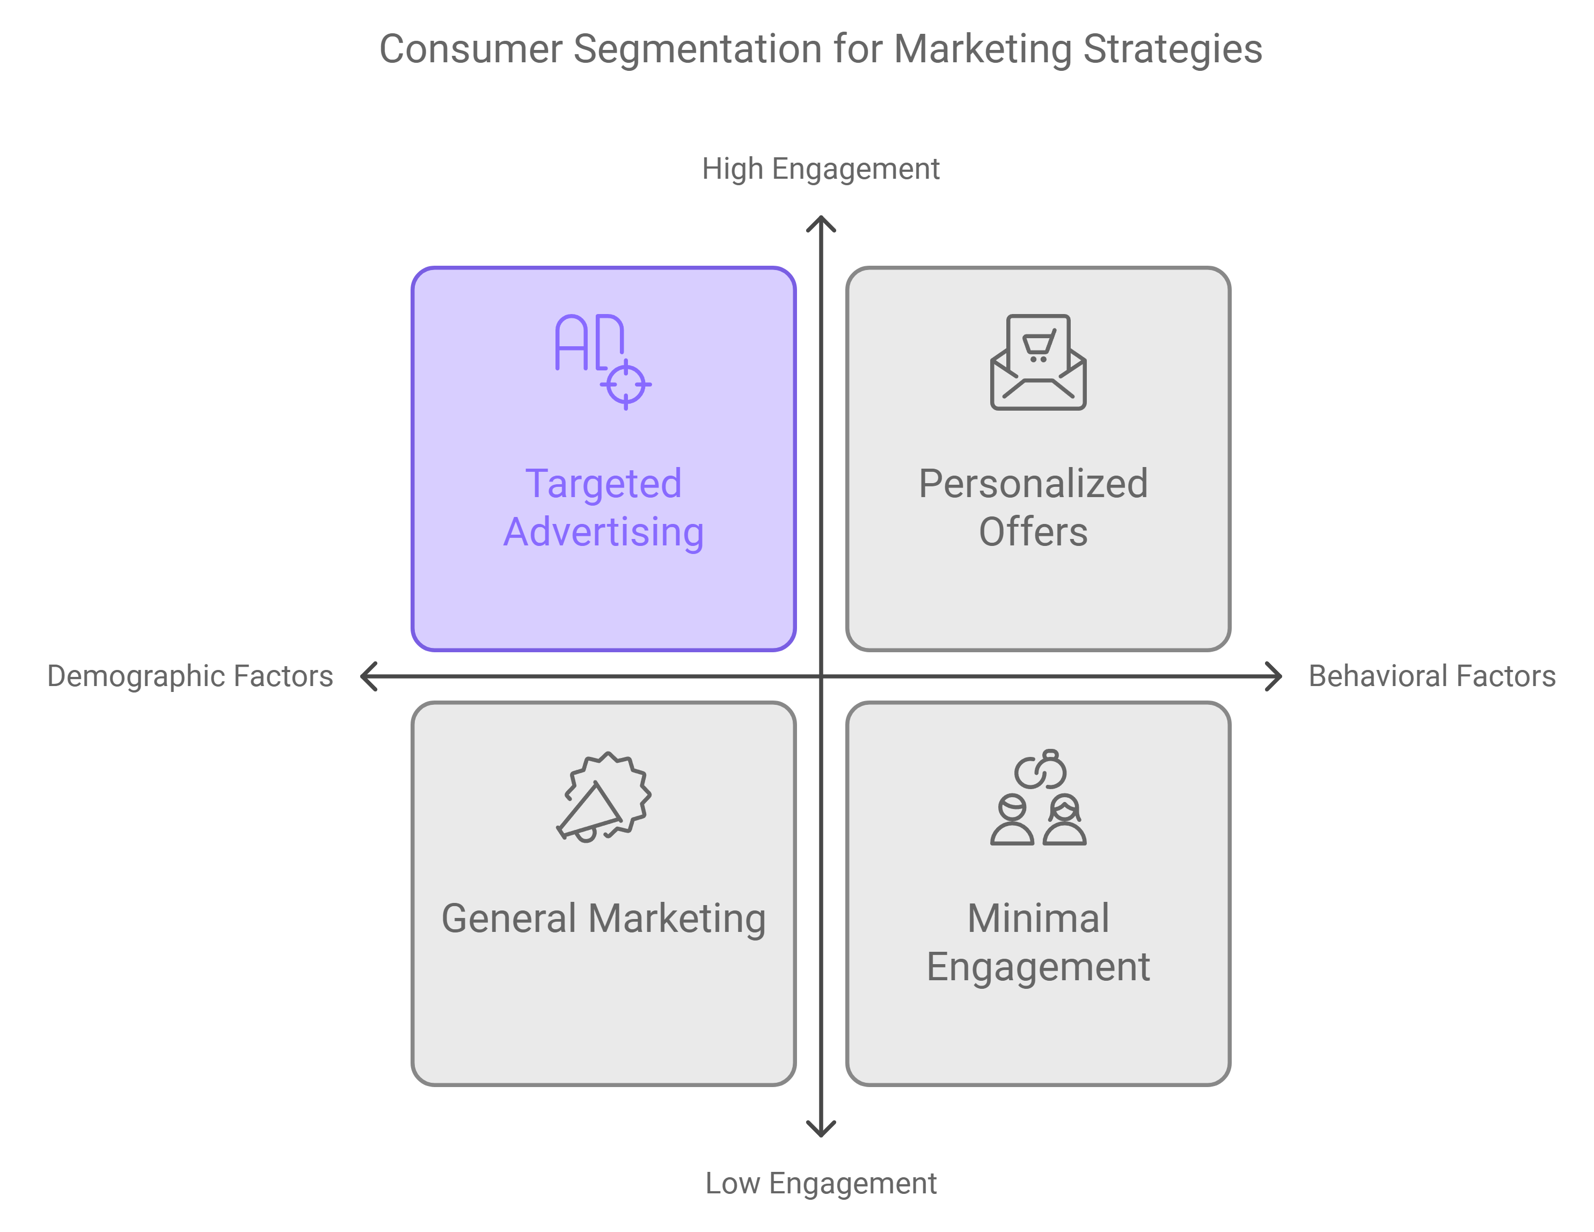
Businesses looking for consumer segmentation to enhance marketing strategies.
Primary Users
5

Slide 6
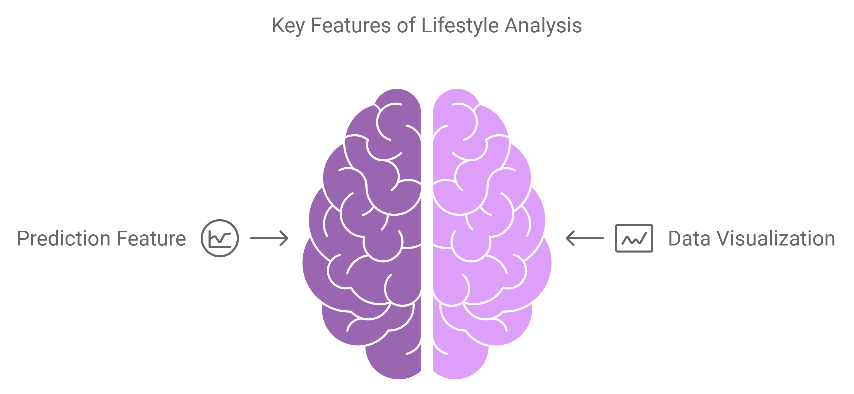
Notes:
Prediction Feature: Input data on age, spending habits, and behaviors to predict lifestyle choices. Data Visualization: Visual reports on feature importance and trends related to lifestyle predictions.

Slide 7

Data Structure
7

Slide 8
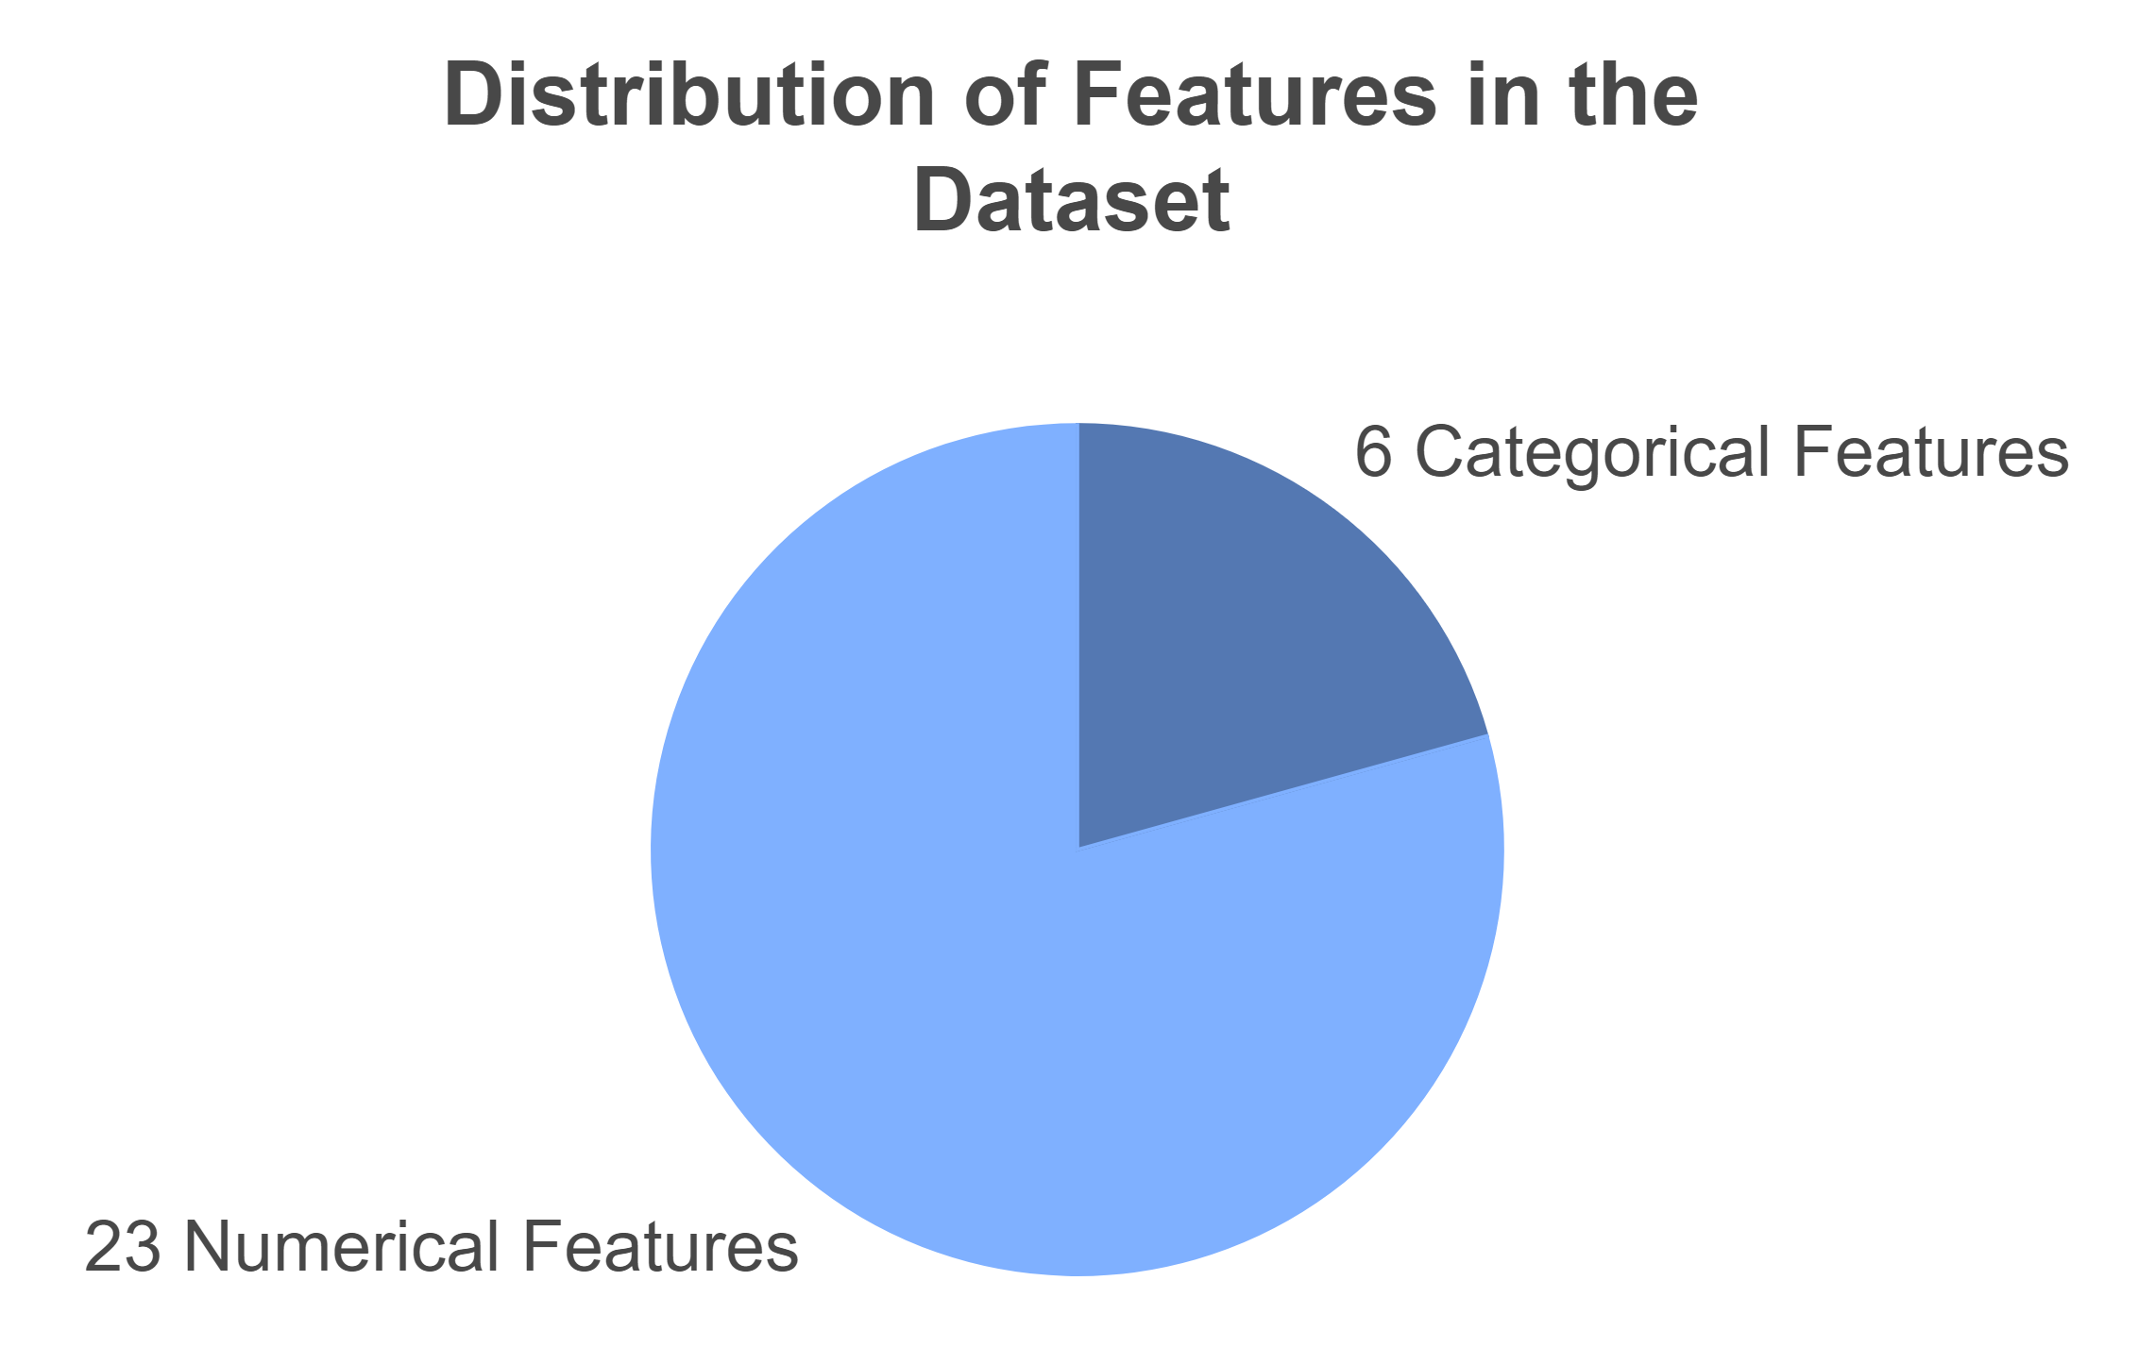
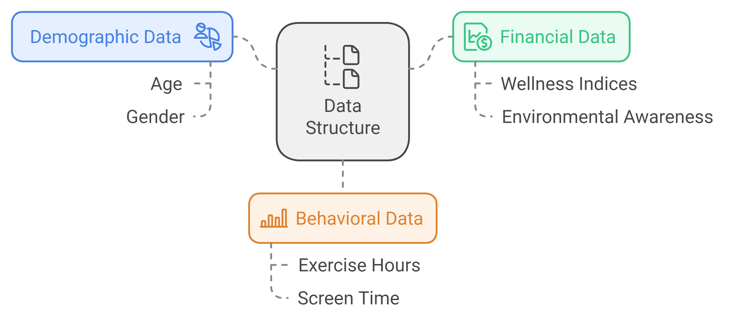
The dataset consists of 475,675 records
Data Overview
Notes:
The dataset consists of 475,675 records with 29 features (6 categorical, 23 numerical). It includes demographic (age, gender), financial (wellness indices, environmental awareness), and behavioral (exercise hours, screen time) data.

Slide 9
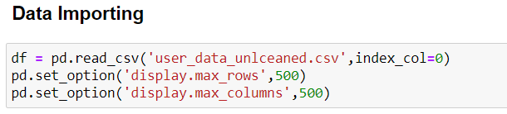
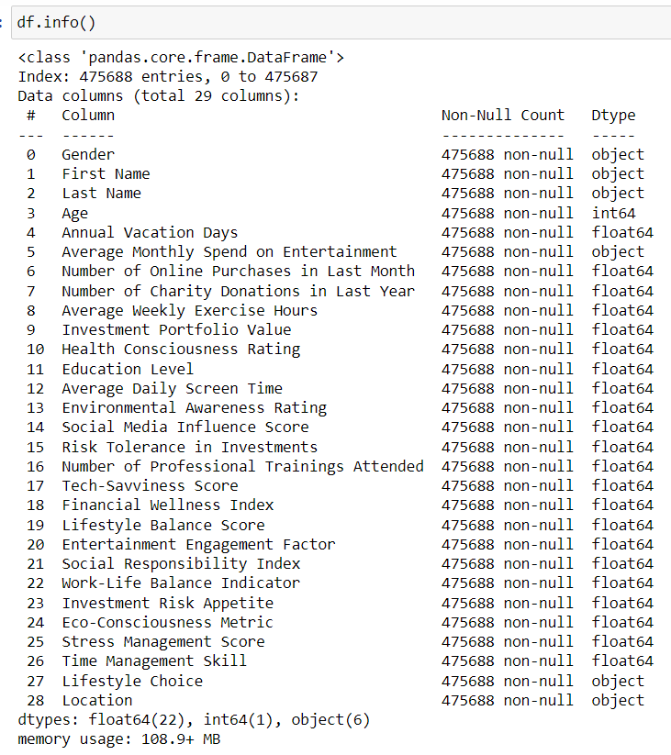
Data information

Slide 10
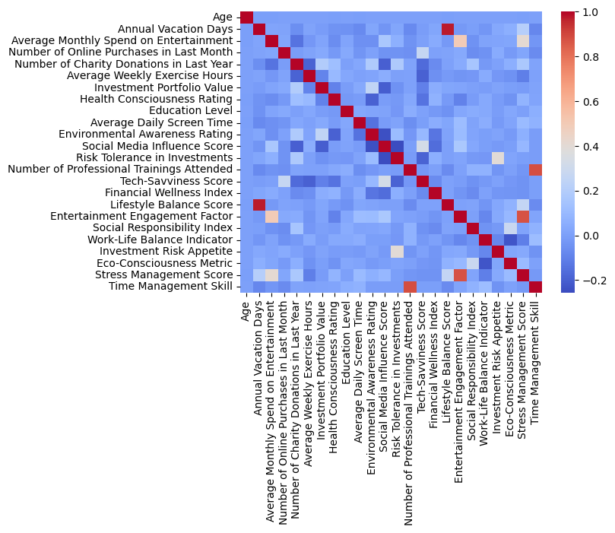
Relationships Between Data Points
Notes:
High collinearity pairs (above 0.7):
Annual Vacation Days And Lifestyle Balance Score: We think about dropping "Annual Vacation Days". The "Lifestyle Balance Score" seems to be a more comprehensive metric that likely incorporates vacation time along with other factors.
Time Management Skill And Number of Professional Trainings Attended:We think about dropping "Number of Professional Trainings Attended". "Time Management Skill" is likely more directly relevant to productivity and overall performance. The number of trainings attended might be just one factor contributing to time management skills.
Stress Management Score And Entertainment Engagement Factor: We think about dropping "Entertainment Engagement Factor". The "Stress Management Score" appears to be more directly related to an individual's well-being and ability to handle workplace pressures. While entertainment engagement might contribute to stress management, it's likely just one of many factors, and the Stress Management Score probably provides a more holistic view. `

Slide 11
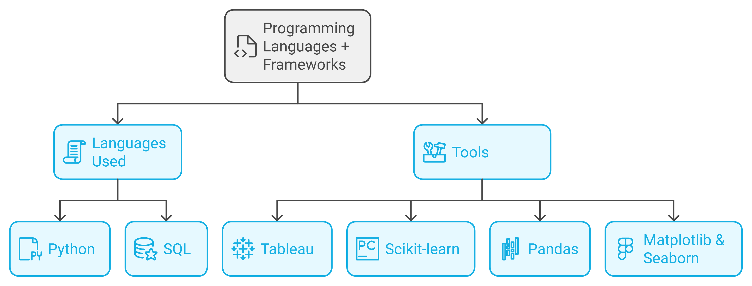
Programming Languages

Slide 12

Project Pipeline

Slide 13
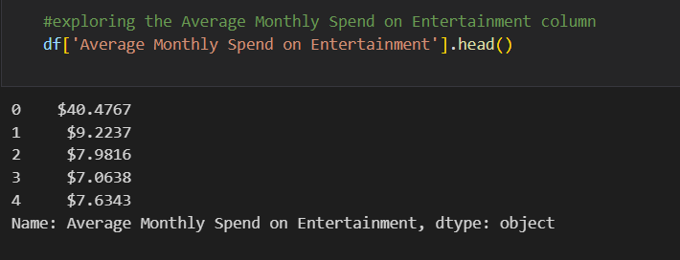
1- Data Cleaning
Fixing Average Monthly Spend on Entertainment Datatype

Slide 14
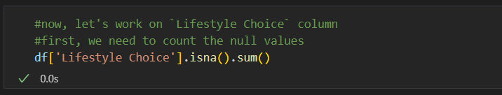
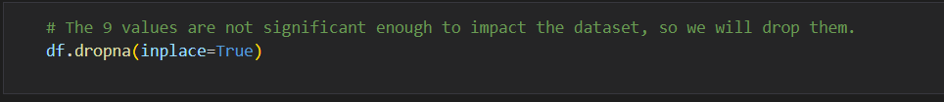
1- Data Cleaning
Handling Missing Values in Lifestyle Choice

Slide 15
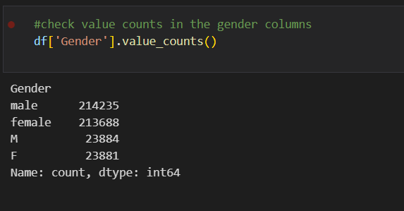
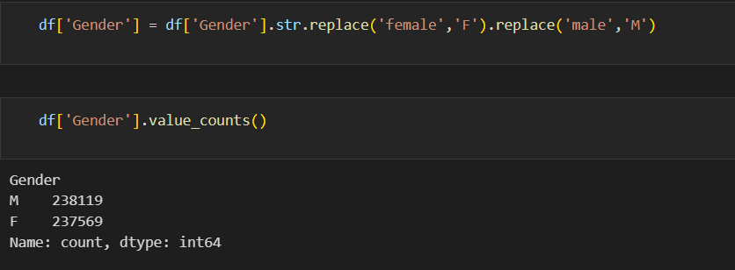
1- Data Cleaning
Standardizing Gender Values (M/F)

Slide 16
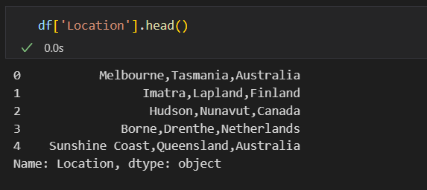
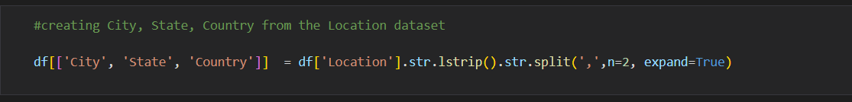
1- Data Cleaning
Expanding Location Column (City, State, Country)

Slide 17
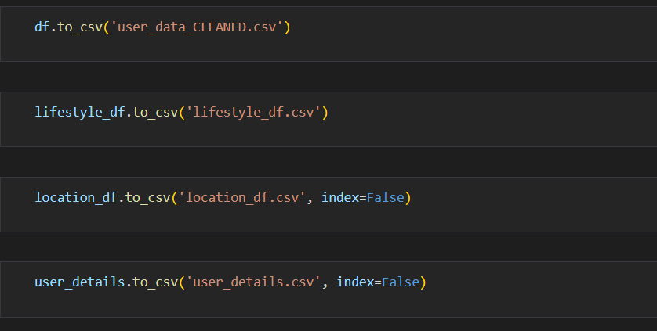
1- Data Cleaning
Database Normalization
Notes:
Our data after cleaning is 32-column, so it's worth cosidering normalization to facilitate the upcoming data analysis and visulization, as well as, making storing data in a rational database easier.
So we are gonna expand the `df` into 3 tables one for `Location` entity, the other for `User_details` entity, and the last one is our main table which is `Lifestyles`.

Slide 18
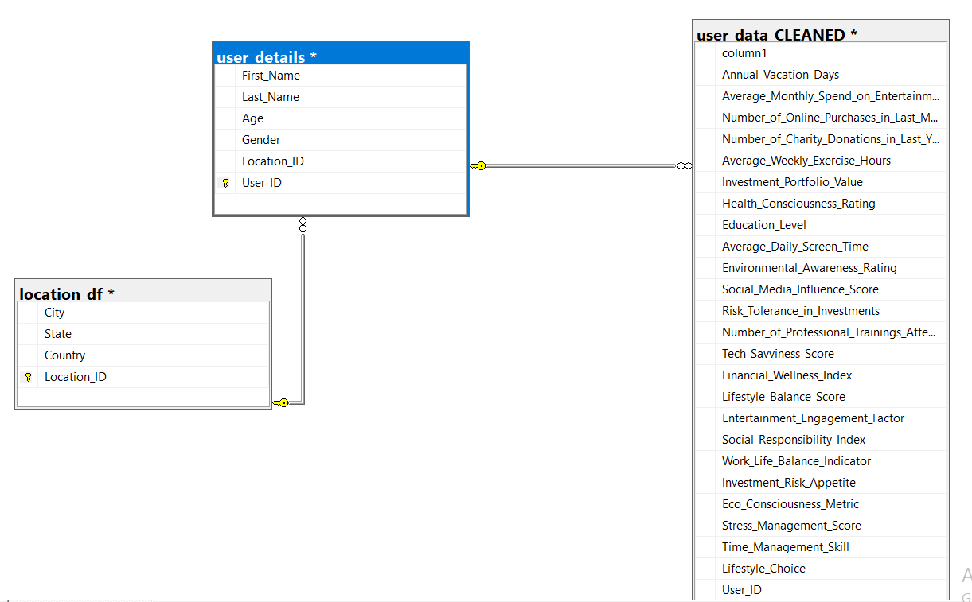
2- Data Exploratory Analysis (SQL)
Data modeling

Slide 19
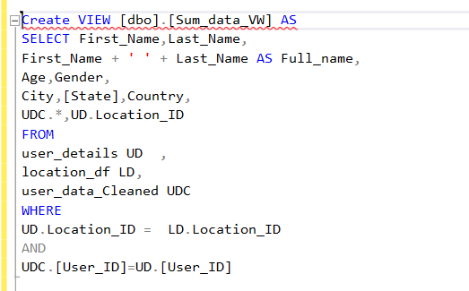
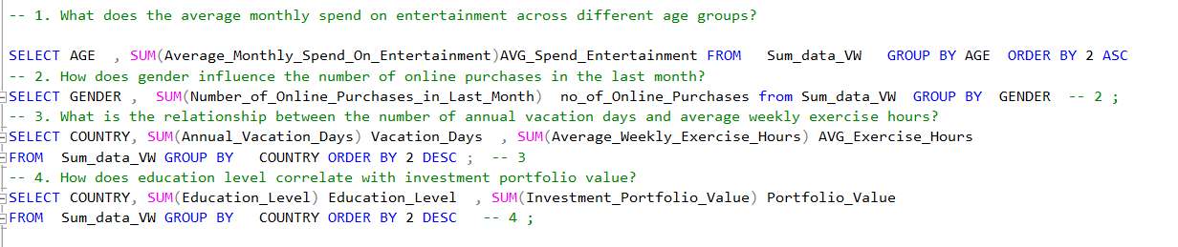
2- Data Exploratory Analysis (SQL)
General EDA

Slide 20
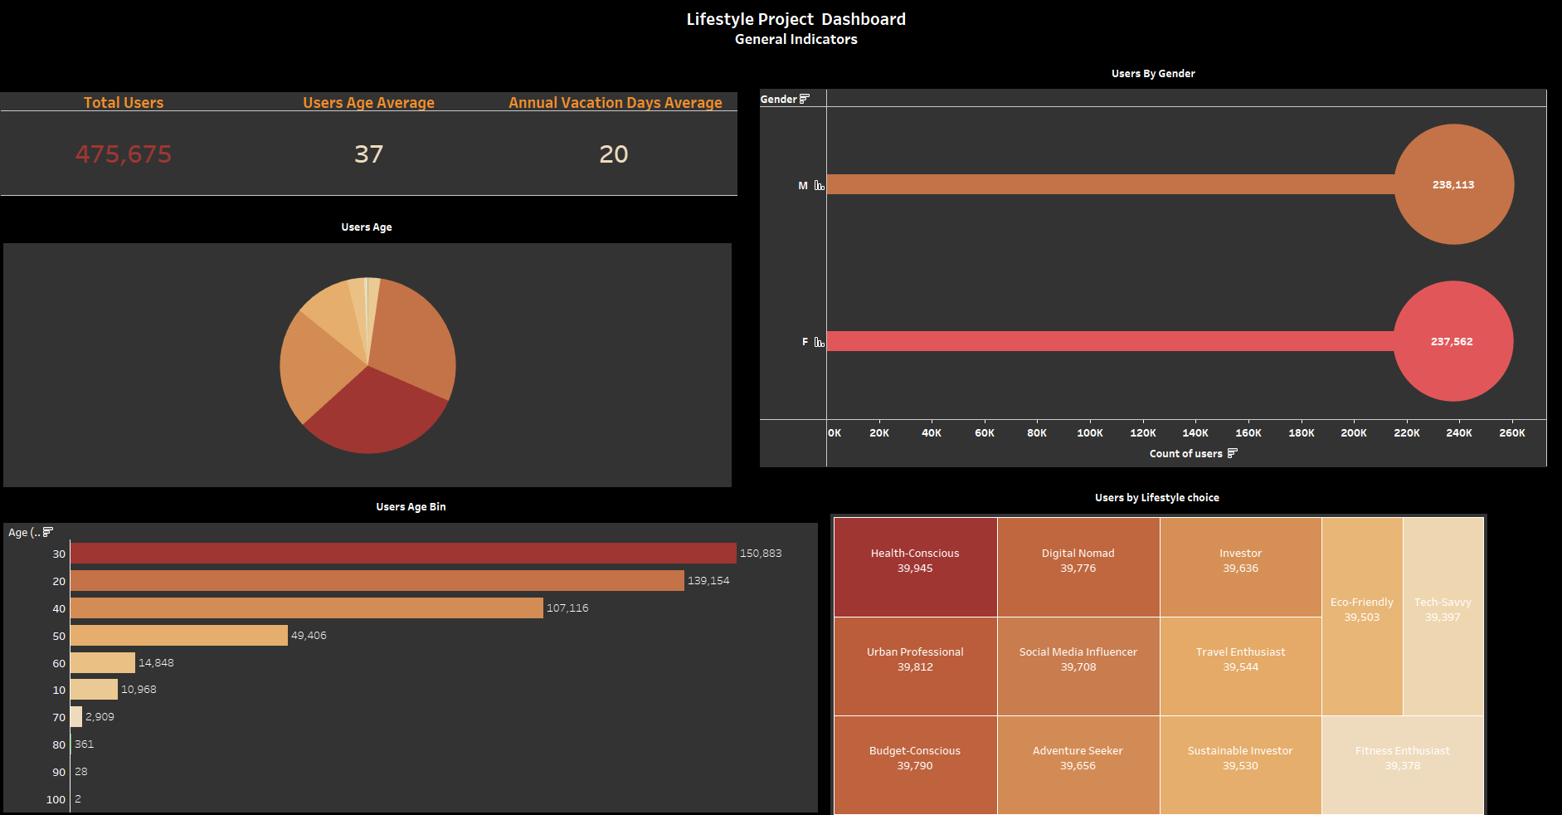
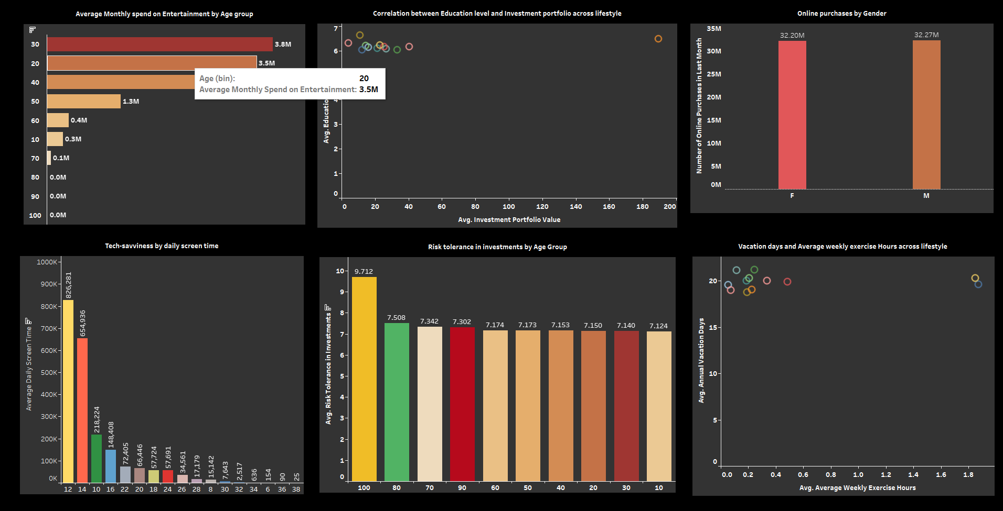
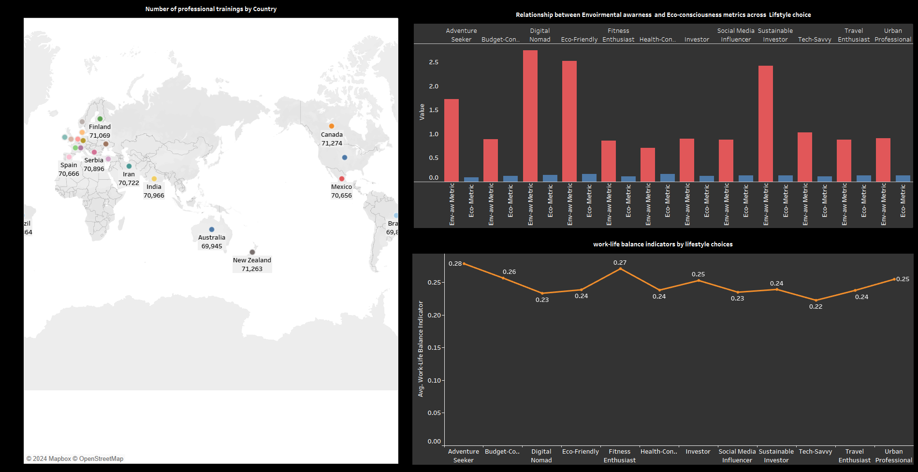
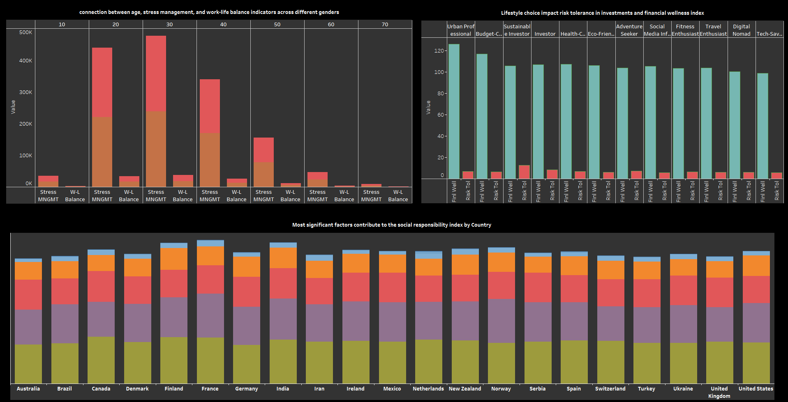
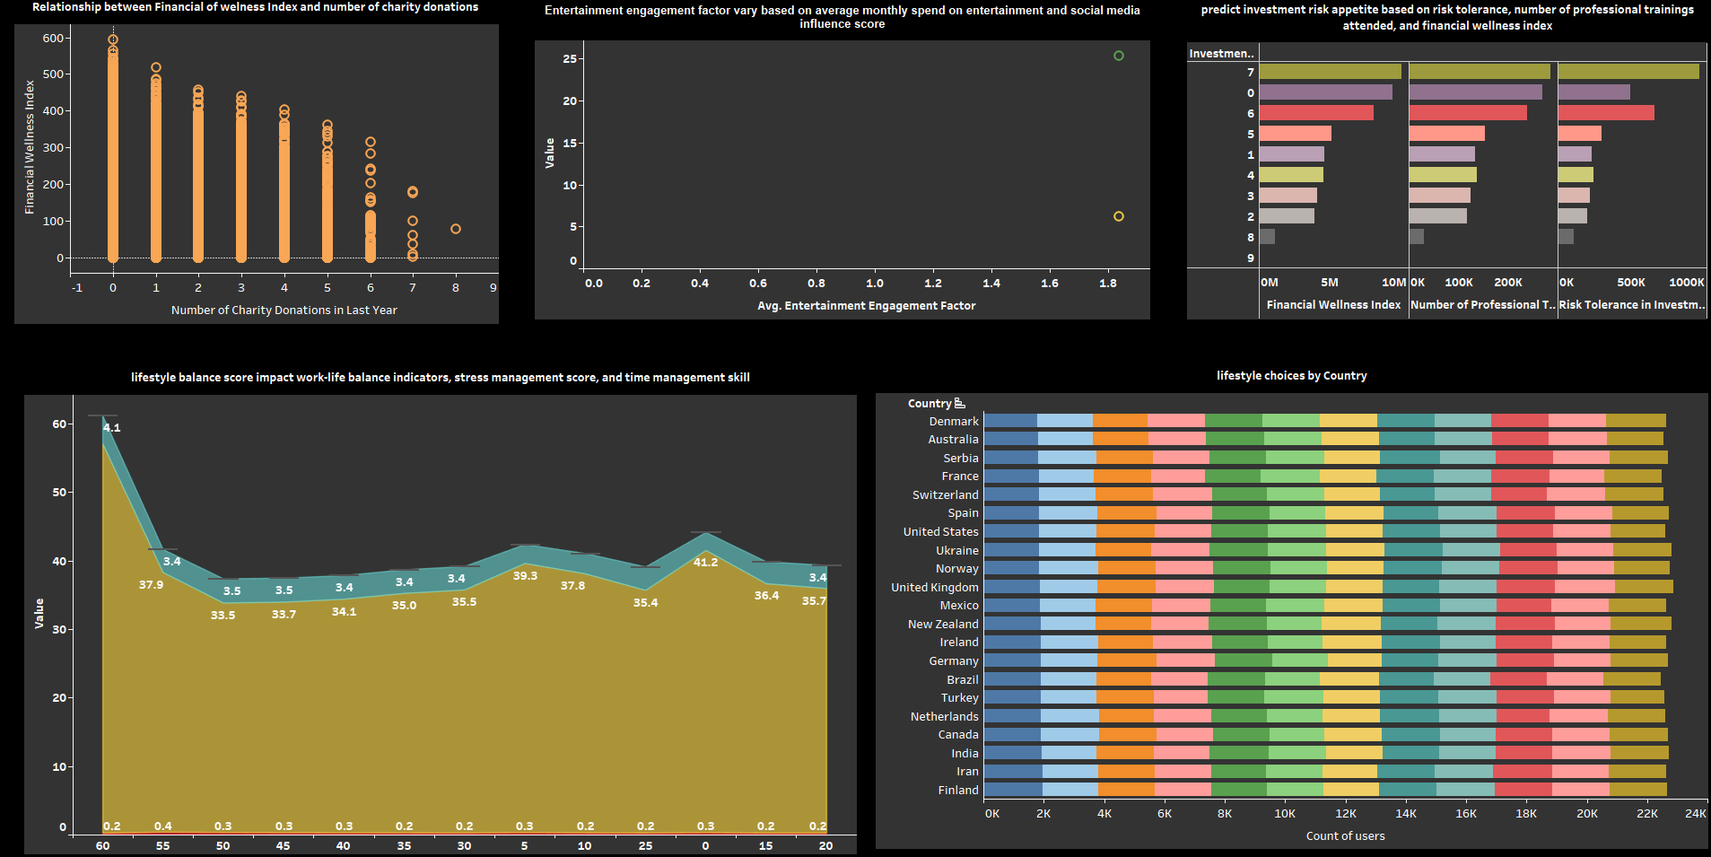
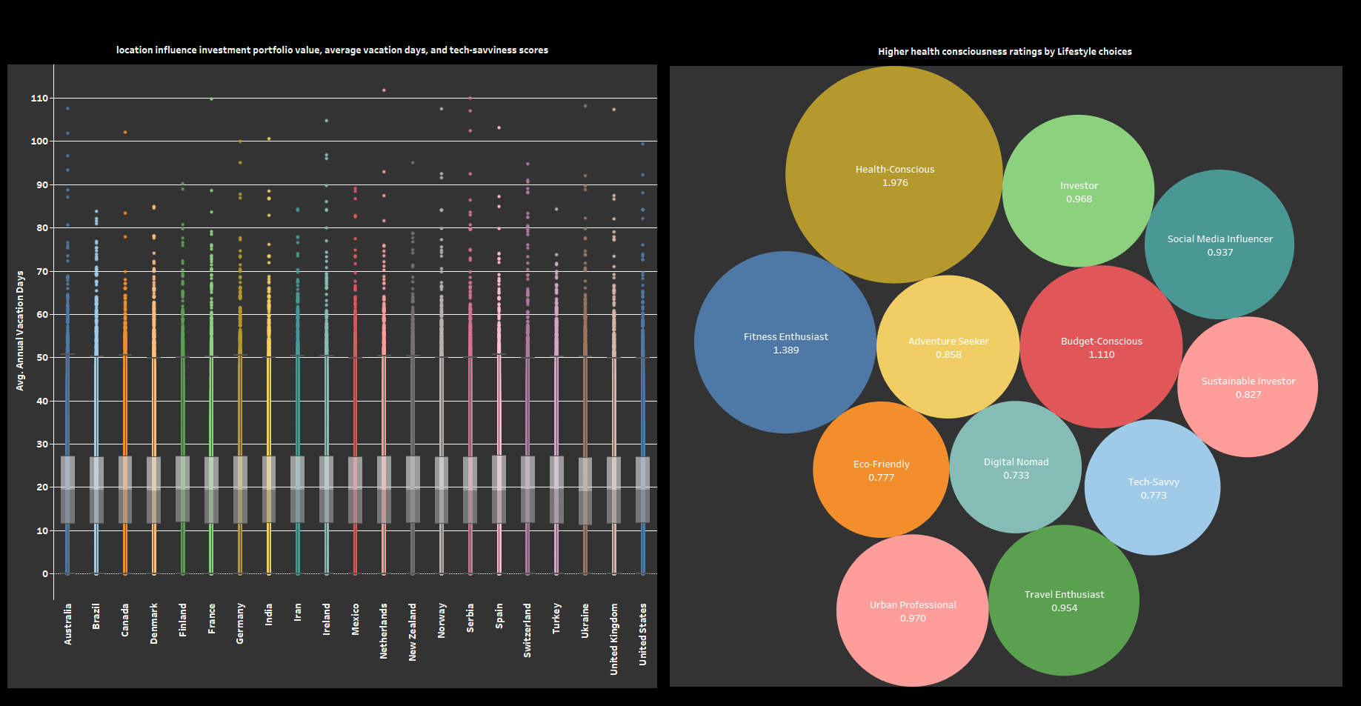
3- Data visualization (Tableau)

Slide 21
3- Data visualization (Tableau)
Notes:
في الداشبورد ده، بنعرض شوية معلومات عامة عن المستخدمين في مشروع Lifestyle Choice Dashboard، والمعلومات دي بتوضح حاجات زي:
إجمالي عدد المستخدمين: وده عدد المستخدمين في الداتا كلها، اللي هو 475,675.
متوسط عمر المستخدمين: اللي هو حوالي 37 سنة.
متوسط عدد أيام الإجازة السنوية: اللي هو 20 يوم في السنة.
وفي رسومات تانية كمان بتوضح أكتر:
رسم بياني دائري: ده بيوضح توزيع المستخدمين حسب العمر.
شريط أفقي فيه عدد المستخدمين حسب النوع، سواء ذكور أو إناث، وبنبين عددهم في كل فئة.
شريط أفقي تاني بيركز على توزيع المستخدمين حسب الـ Lifestyle Choice بتاعهم، فمثلاً بنشوف الناس اللي اختاروا "Health Conscious" كام عددهم، وكمان باقي الفئات زي "Social Media Influencer" وهكذا.

Slide 22
3- Data visualization (Tableau)
Notes:
عندنا فوق على الشمال شارت بتوضح متوسط الـ "Monthly Spend on Entertainment" لكل "Age Group". يعني هنا بنشوف الفئات العمرية المختلفة وأكتر قد إيه كل فئة بتصرف على الترفيه.
جنبها شارت بتوضح العلاقة بين "Education Level" و"Investment Portfolio" عبر الـ "Lifestyle". يعني بنشوف لو التعليم ليه علاقة بطريقة استثمار كل فئة.
تحت على الشمال في شارت بتعرض توزيع عدد الناس على حسب "City" بتاعتهم.

Slide 23
3- Data visualization (Tableau)
Notes:
على الشمال فوق فيه توزيع الـ "Investment Portfolio Value" حسب الـ "Location"، وده بيوضح لنا لو في علاقة بين مكان الإقامة وقيمة المحفظة الاستثمارية.
في النص فيه دايرة كبيرة متقسمة لألوان مختلفة، دي بتوضح تصنيف الناس حسب "Health Consciousness" لكل "Lifestyle Choice". زي مثلاً إن فيه فئة كبيرة من "Fitness Enthusiast".
وعلى اليمين فوق عندنا شارت بيبين العلاقة بين العمر و"Stress Management" حسب كل "Gender"، وبنشوف ازاي الجنس والعمر بيأثروا على إدارة الضغط.

Slide 24
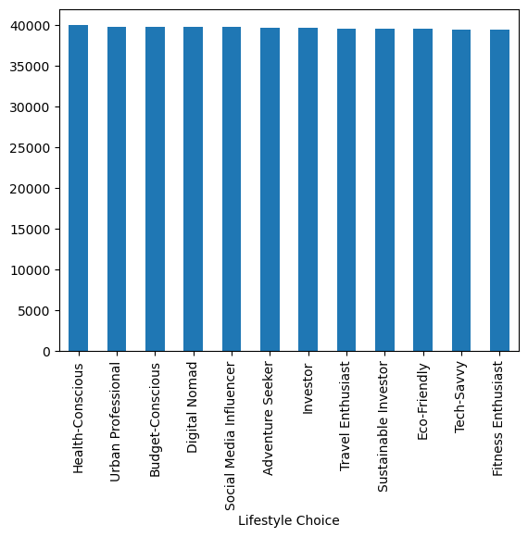
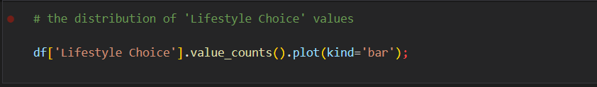
4- Data Preprocessing (Python)
Analyze Distribution of Target Variable

Slide 25
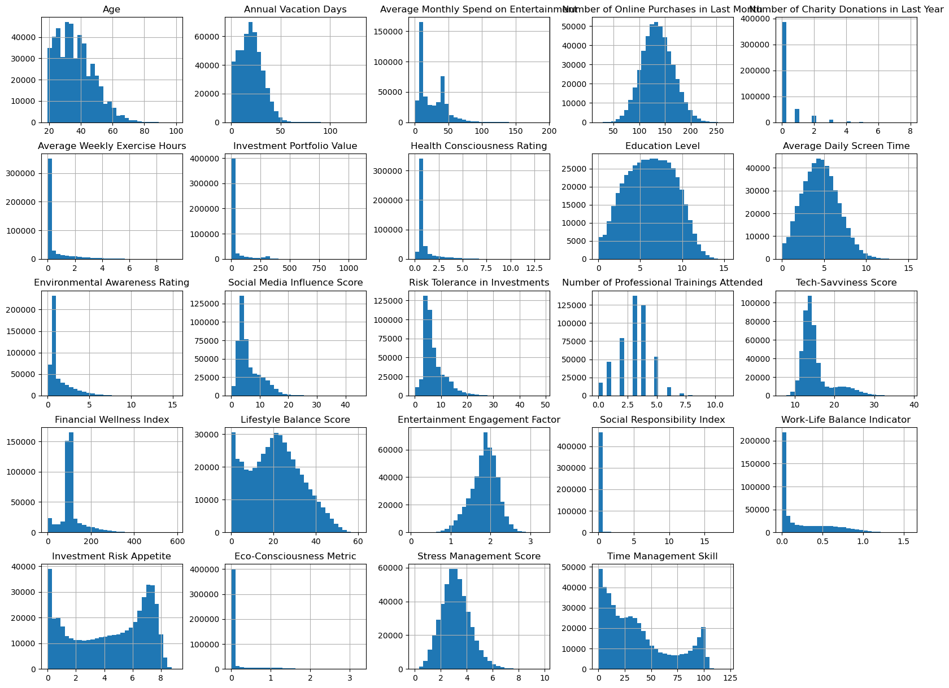
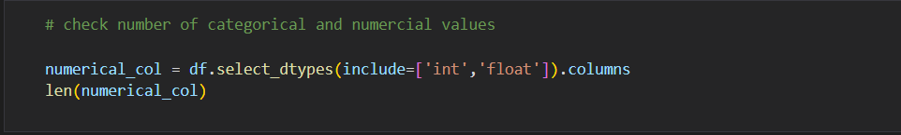
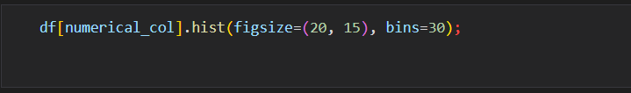
4- Data Preprocessing (Python)
Visualize Distributions of Numerical Columns

Slide 26
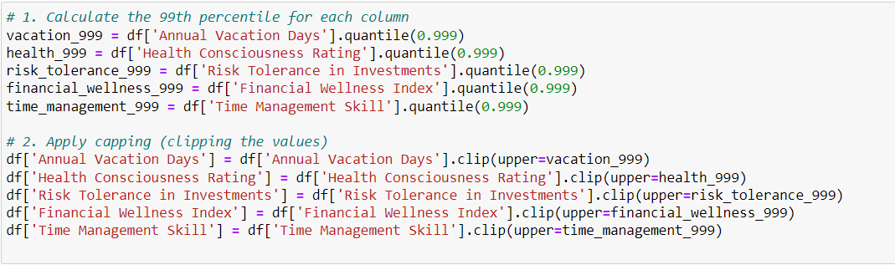
4- Data Preprocessing (Python)
Handling Unreasonable Outliers
The most unreasonable extreme values are found in:
Annual Vacation Days (129.75 days)
Health Consciousness Rating (13.43 on what seems to be a much lower scale)
Risk Tolerance in Investments (48.99 on what seems to be a much lower scale)
Financial Wellness Index (593.79, which is extremely high compared to the mean)
Time Management Skill (121.64, which is likely on a 0-100 scale)

Slide 27
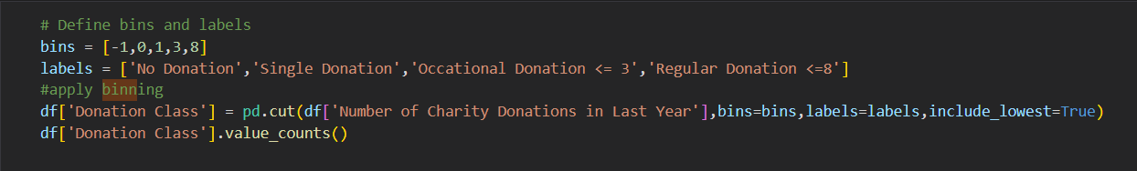
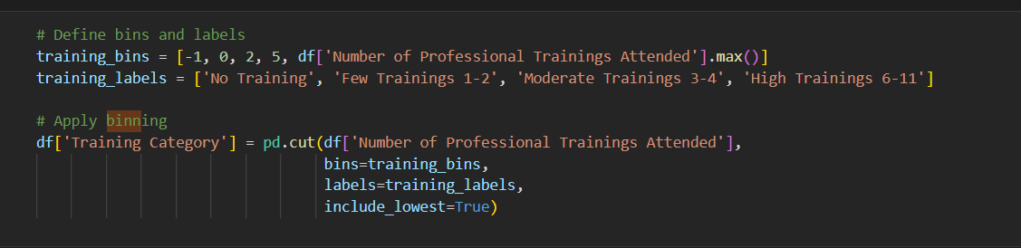
4- Data Preprocessing (Python)
Binning Certain Features

Slide 28
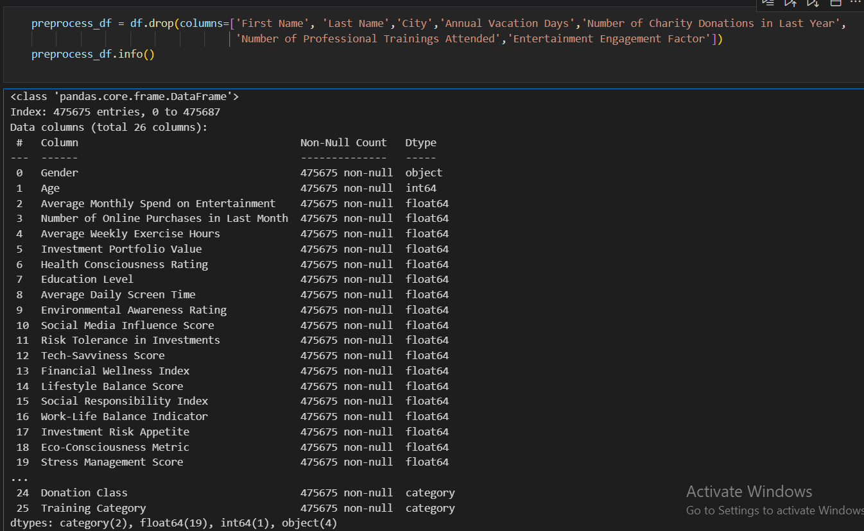
4- Data Preprocessing (Python)
Dropping High Collinearity and Redundant Columns

Slide 29
5- Model selection
Dataset Overview: Contains over 400,000 records (medium size).
High-dimensional Columns Removed: Some high-dimensionality remains.
Outliers Handled: Capped extreme values.
Modeling Approach: Random Forest algorithm will be used.

Slide 30
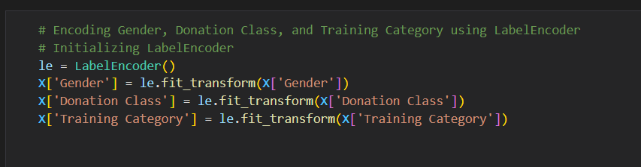
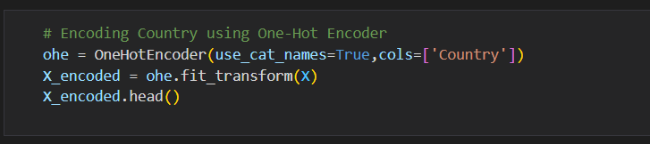
5- Model selection
Encoding Categorical Variables:
LabelEncoder for binary and ordinal variables (Gender, Donation Class, Training Category).
OneHotEncoder for Country column.
HashingEncoder for State column (high cardinality).
Target Encoding: LabelEncoder applied.

Slide 31
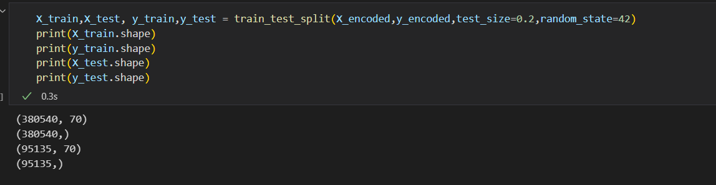
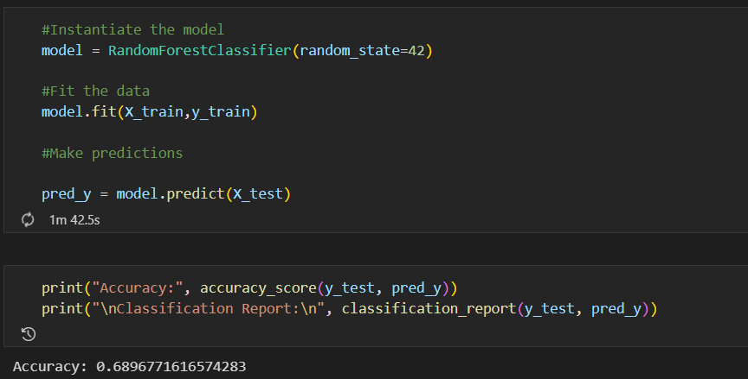
6- Model Building (Python)
Train-Test Split: 80% training, 20% testing.
Model Training: Achieved accuracy of 0.68 on test set.

Slide 32
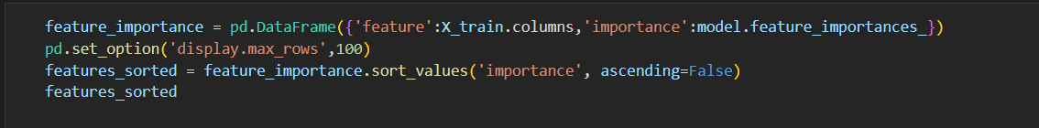
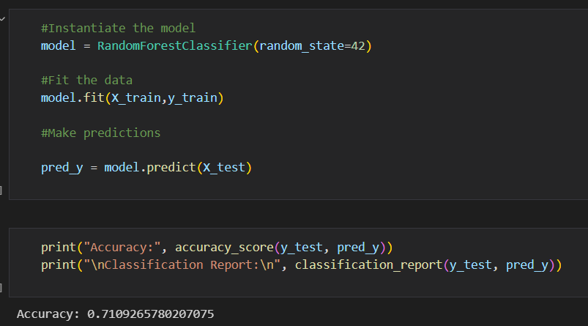
6- Model Building (Python)
Feature Importance: Top 18 important features selected.
Model Re-training: Improved performance using important features.

Slide 33
Deliverables

Slide 34
Deliverables
Dataset (CSV file)
A comprehensive description that effectively communicates the details of your project.
A ZIP File containing your Project Source Code. (python, sql)
A URL to your Live application, system, or dashboard after deployment. (Tableau public)
Project Documentation (project design, wireframe, model, visualizations, tutorials, report, etc.)

Slide 35
Milestone AND Team Members

Slide 36
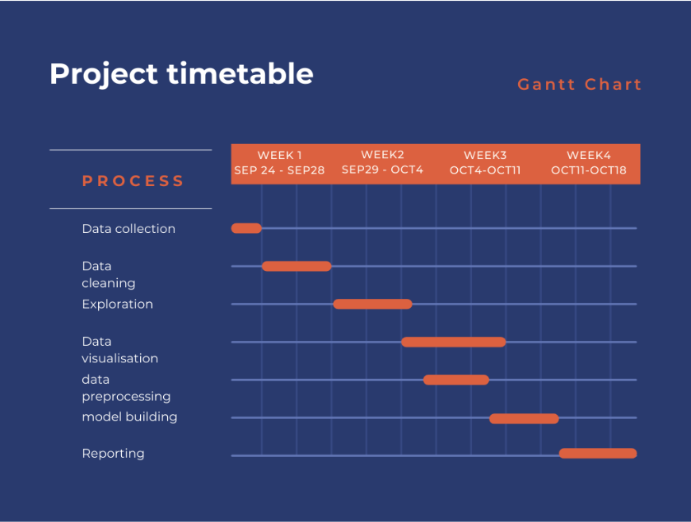
TimeTable

Slide 37
Team members
Doaa Mohamed – Exploratory Data analysis (SQL)
Jehad Essam – Exploratory Data analysis (SQL)
Mariam Badr – Data cleaning, preprocessing, model building (Python)
Mohamed Mostafa – Data visualization (Tableau)
Mohamed Essam – Data visualization (Tableau)

Slide 38
Recommendations
Exploring other algorithms (e.g., neural networks, gradient boosting) to improve prediction accuracy.
Deploying the model to provide real-time predictions, enabling stakeholders to make timely data-driven decisions.
Encourage the development of a mechanism to gather user feedback on predictions to improve model performance continuously.

Slide 39

For Any Further Information please contact:
Mariam Badr
01143755257
11/6/2024

